Slide 1
Problem statement :
Speech to Text App customized for police functioning in different languages.
Devise a solution for the security agencies which can be used for multiple regional languages. This solution should be accurate and efficient in converting speech to text for the security personnel.
Domain : cyber security
PROGRAMMING LANGUAGE USED : PYTHON

Slide 2
INTRODUCTION:
Speech Recognition is an important feature in several applications used such as home automation, artificial intelligence, etc.
instAllations required :
- PYTHON SPEECH RECOGNITION MODULE
pip install speech recognition
pyaudio
pip install pyaudio (for windows)
sudo apt-get install python3-pyaudio (for linux)
Python pyttsx3 module
pip install pyttsx3

Slide 3
Speech Input Using a Microphone and Translation of Speech to Text :
Allow Adjusting for Ambient Noise: Since the surrounding noise varies, we must allow the program a second or too to adjust the energy threshold of recording so it is adjusted according to the external noise level.
Speech to text translation: This is done with the help of Google Speech Recognition. This requires an active internet connection to work. However, there are certain offline Recognition systems such as PocketSphinx, but have a very rigorous installation process that requires several dependencies. Google Speech Recognition is one of the easiest to use.

Slide 4
Speech recognition technology helps meet the challenge :
As police departments look for ways to better serve their communities, speech recognition technology such as ”Nuance Dragon Law Enforcement” increases productivity, efficiency and safety while allowing officers to be “heads-up” in the patrol car and more situationally aware. More law enforcement professionals are turning to new technologies such as speech recognition to help reduce the burden of documentation so they can do what they do best –spend time in the community, protecting and serving the public.

Slide 5
5 ways speech recognition technology helps solve law enforcement challenges :
1. INCREASED SITUATIONAL AWARENESS
2. iNCREASED ACCURACY IN INCIDENT REPORTING
3. INCIDENT REPORTS FILED IN A MORE-TIMELY MANNER
4. INCIDENT REPORTS FILED IN A MORE-TIMELY MANNER
5. MINIMIZED PHYSICAL DISCOMFORT

Slide 6
Speech & voice recognization market dynamics :
Speech and voice recognition market scel 2022 and is anticipated to be USD 26.1 billion by 2027.
growing at a CAGR of 24% em 20222027Factors such as Increasing demand in healineace for improving afinency and the growing of appliances are driving the growth of the market during the forecast period.

Slide 7
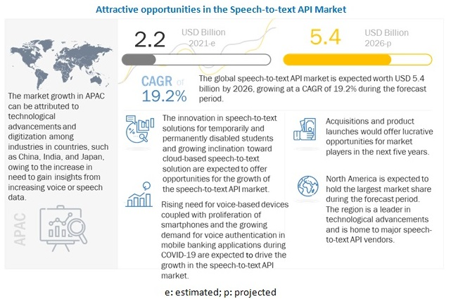

Slide 8
THE PANTHERS
MEMBERS:
NISTHA BHURA
ANURAG KUMAR
DEEPAK SAINI
ROHIT RAJ

